Slide 1
Cluster-based Analysis of Molecular Simulations
Alex Rodriguez
International School for Advanced Studies (SISSA), Trieste, Italy

Slide 2
Overview (I)
Clustering:
Unsupervised learning.
It attempts looking for “natural” structures on your data.

Slide 3
Overview (I)
Clustering:
Unsupervised learning.
It attempts looking for “natural” structures on your data.
Kind of data: Protein sequences, snapshots along a trajectory, chemical compounds…)
Features/descriptors/variables: Letters, Collective Variables, atom positions, Coulomb matrix…
Distances: Hamming, Euclidean, RMSD, Euclidean norm of diagonalized matrix…
Method for clustering: k-means, etc

Slide 4
Overview (II)
Feature Selection:
For obtaining a meaningful cluster description, we should restrict the features of our data to those relevant for the problem that we want to study.
If we know some kind of ground truth classification, it can be done by variable ranking or subset selection.
Variable ranking consists in assign a score to the correlation between the single feature and the ground truth. High scores imply that the feature is really important for obtaining the ground truth.
We have focused on the Mutual Information, but there are other scores (Pearson correlation, Jaccard index,etc).
In variable ranking remains unclear how to treat features that act together. → subset selection (high computational cost)

Slide 5
Overview (III)
Dimensional reduction:
Without ground truth, dimensional reduction can be needed for avoiding too noise classification.
There are many dimensional reduction methods, we focus on PCA, that projects our data on the eigenvector basis coming from the diagonalization of the covariance matrix.
How to decide the number of PC’s.
λ₂
λ₁

Slide 6
Overview (IV)
Clustering methods:
Divided in flat, fuzzy and hierarchical clustering.

Slide 7
Flat clustering
5
1
3
2
4

Slide 8
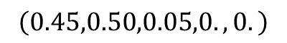
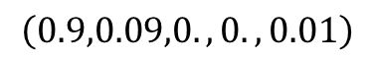
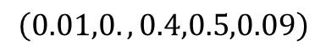
Fuzzy clustering
$$\left(0.9,0.09,0.,0.,0.01\right)$$
$$\left(0.01,0.,0.4,0.5,0.09\right)$$
$$\left(0.45,0.50,0.05,0.,0.\right)$$

Slide 9
Hierarchical clustering

Slide 10
Overview (IV)
Clustering methods:
Divided in flat, fuzzy and hierarchical clustering.
K-means clustering:
Widely used
Attempts to minimize the intracluster distance while maximizing the intercluster distance.
The number of clusters is not easy to stablish.
Results depend on initialization.
Sensible to the presence of outliers.
It cannot deal with non-convex clusters.

Slide 11
Today
Clustering:
Unsupervised learning.
It attempts looking for “natural” structures on your data.
Kind of data: Protein sequences, snapshots along a trajectory, chemical compounds…)
Features/descriptors/variables: Letters, Collective Variables, atom positions, Coulomb matrix…
Distances: Hamming, Euclidean, RMSD, Euclidean norm of diagonalized matrix…
Method for clustering: k-means, etc

Slide 12
Some problems with the discussed algorithms
K-means and fuzzy c-means are not well suited to deal with arbitrary shape (non-convex) clusters.
Which intercluster distance shall we use for hierarchical clustering?
What happens with noisy data sets?
Which should be the final number of clusters?

Slide 13
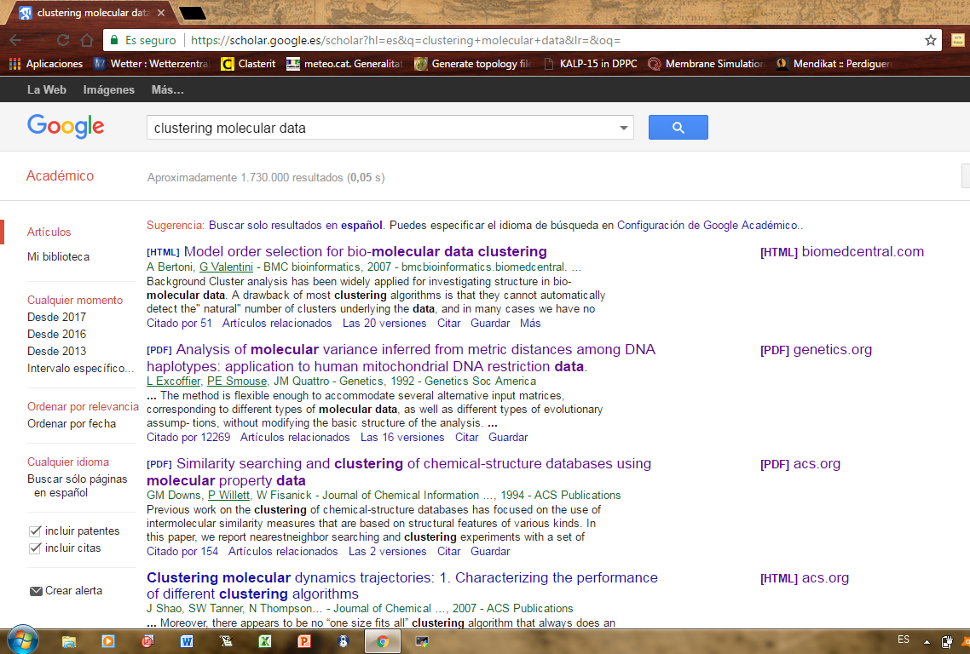

Slide 14
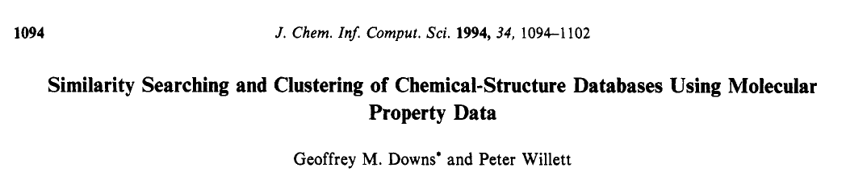
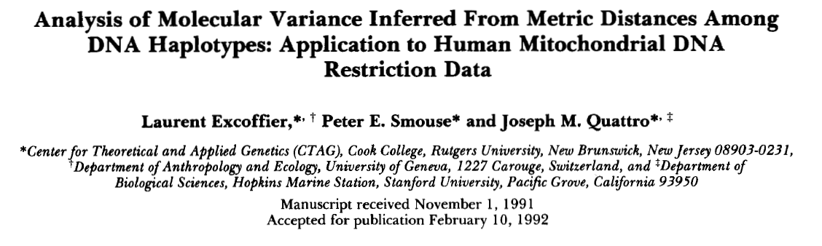
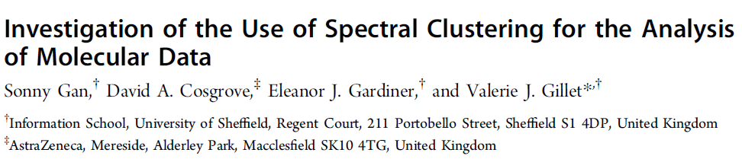
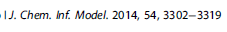

Slide 15
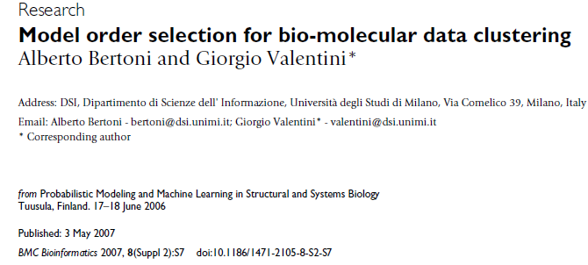
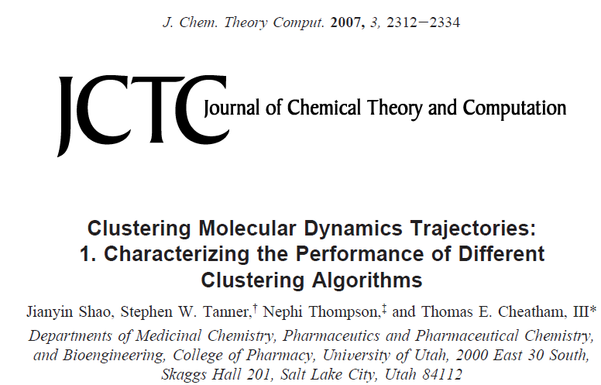

Slide 16
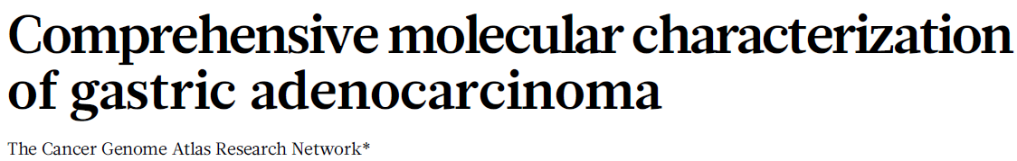
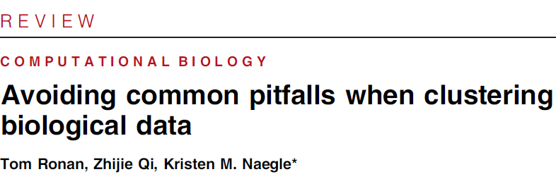

Slide 17
Clustering methods
Last survey I’m aware of:
Xu, D., & Tian, Y. (2015). A comprehensive survey of clustering algorithms. Annals of Data Science, 2(2), 165-193.

Slide 18
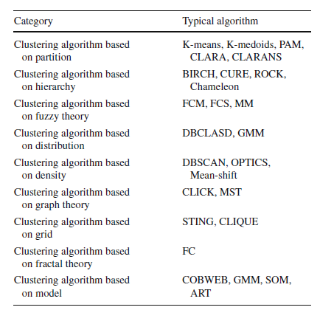
Traditional clustering methods

Slide 19
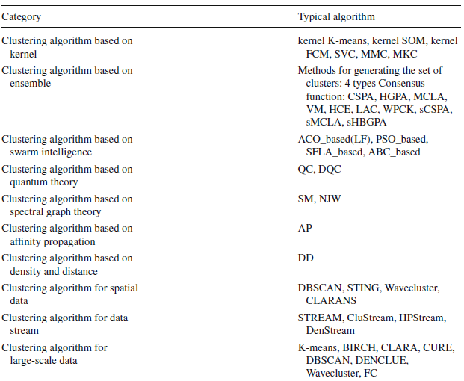
Modern clustering methods

Slide 20
Expectation-Maximization clustering
Modern clustering algorithms (I)

Slide 21
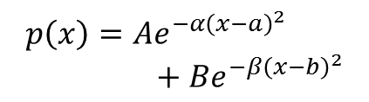
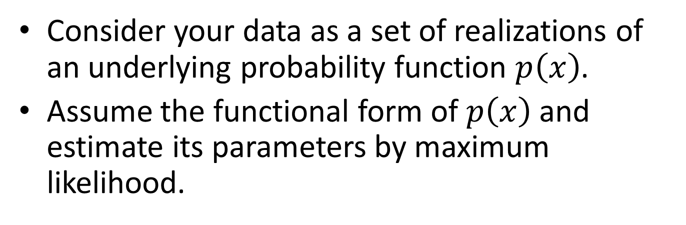
Model based clustering
Consider your data as a set of realizations of an underlying probability function $p\left(x\right)$.
Assume the functional form of $p\left(x\right)$ and estimate its parameters by maximum likelihood.
$$p\left(x\right)=Ae^{−{α\left(x−a\right)}^{2}}+Be^{−{β\left(x−b\right)}^{2}}$$
A_{opt}
A₀
B_{opt}
B₀
β₀
β_{opt}
α₀
α_{opt}
a_{opt}
a₀
b₀
b_{opt}

Slide 22
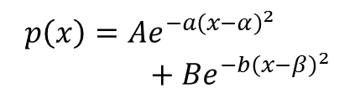
Model based clustering
Consider your data as a set of realizations of an underlying probability function $p\left(x\right)$.
Assume the functional form of $p\left(x\right)$ and estimate its parameters by maximum likelihood.
$$p\left(x\right)=Ae^{−a{\left(x−α\right)}^{2}}+Be^{−b{\left(x−β\right)}^{2}}$$
A_{opt}
B_{opt}
β_{opt}
α_{opt}
a_{opt}
b_{opt}

Slide 23
Expectation-maximization algorithm
Iterative procedure to compute the Maximum Likelihood (ML) estimate – even in the presence of missing or hidden data
EM consists of two steps:
Expectation step: the (missing) data are estimated given the observed data and current estimates of model parameters
Maximization step: The likelihood function is maximized under the assumption that the (missing) data are known

Slide 24
EM algorithm for mixture of Gaussians
What is a mixture of K Gaussians?
with
and F(x|Θ) is the Gaussian distribution with parameters Θ = {μ,Σ}

Slide 25
EM algorithm for mixture of Gaussians
If all points xєX are mixtures of K Gaussians then
Goal: Find π₁,…, π_{k} and Θ₁,…, Θ_{k} such that P(X) is maximized
Or, ln(P(X)) is maximized:

Slide 26
Mixtures of Gaussians -- notes
Every point x_{i} is probabilistically assigned (generated) to (by) the k-th Gaussian
Probability that point x_{i} is generated by the k-th Gaussian is

Slide 27
Mixtures of Gaussians -- notes
Every Gaussian (cluster) C_{k} has an effective number of points assigned to it N_{k}
With mean
And variance

Slide 28
EM for Gaussian Mixtures
Initialize the means μ_{k}, variances Σ_{k} (Θ_{k}=(μ_{k},Σ_{k})) and mixing coefficients π_{k}, and evaluate the initial value of the loglikelihood
Expectation step: Evaluate weights

Slide 29
EM for Gaussian Mixtures
Maximization step: Re-evaluate parameters
Evaluate L(Θ^{new}) and stop if converged

Slide 30
EM characteristics
Notice the similarity between EM for Normal mixtures and K-means: The expectation step is the assignment, while the maximization step is the update of the centers.
If the model (k, functional form) is not realistic, neither will the results.
It is not guaranteed to reach the global optimum.

Slide 31
Density-Based Spatial Clustering of Applications with Noise (DBSCAN)
Modern clustering algorithms (II)

Slide 32
DBSCAN
Density-based Clustering locates regions of high density that are separated from one another by regions of low density.
Density = number of points within a specified radius (ε)
DBSCAN is a density-based algorithm.
A point is a core point if it has more than a specified number of points (MinPts) within ε. These are points that are at the interior of a cluster
A border point has fewer than MinPts within ε, but is in the neighborhood of a core point

Slide 33
DBSCAN
A noise point is any point that is not a core point or a border point.
Any two core points are close enough– within a distance ε of one another – are put in the same cluster
Any border point that is close enough to a core point is put in the same cluster as the core point
Noise points are discarded

Slide 34
Border & Core
Outlier
Border
Core
ε = 1unit
MinPts = 5

Slide 35
Density connected:
p
q
o

Slide 36
DBSCAN: The Algorithm
select a point p
Count the number of neighbors within ε of p, and the number of neighbors of the neighbors of p.
If p is a core point, a cluster is formed, follow the density connection and assign all the points density reachable to the same cluster.
Otherwise, visit the next point of the database.
Continue the process until all of the points have been processed.
At the end of the process, points not assigned are Noise.
Result is independent of the order of processing the points

Slide 37
An Example
MinPts = 4
ε
C₁
C₁
ε
ε
C₁

Slide 38
DBSCAN characteristics
It makes no assumptions about the number of clusters.
It has a unique result.
It is not easy to determine the parameters ε and MinPts.
It does not work properly when determining structures with really different densities.

Slide 39
Fast Search and Find of Density Peaks
Modern clustering algorithms (III)

Slide 40
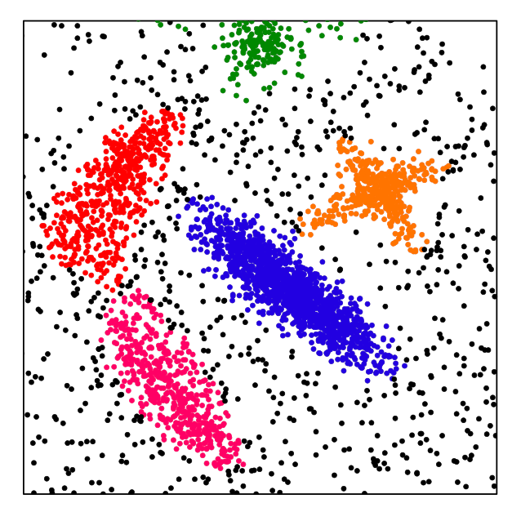
Density Peaks clustering
Clusters = peaks in the density of points*
= peaks in the “mother” probability distribution
*Idea already present in DB-SCAN

Slide 41
Density Peaks: δ concept
Clustering in a 2-dimensional space
1) Compute the local density (ρ) around each point
ρ(1)=7
ρ(8)=5
ρ(10)=4
2) For each point compute the distance from all the points with higher density. Take the minimum value.
2) For each point compute the distance from all the points with higher density. Take the minimum value.

Slide 42
Density Peaks decision graph
3) For each point, plot the minimum distance as a function of the density.
Notes:
Cambiare 8 in 6

Slide 43
Density Peaks decision graph
4) the “outliers” in this graph are the cluster centers

Slide 44
Density Peaks decision graph
4) ) the “outliers” in this graph are the cluster centers
5) Assign each point to the same cluster of its nearest neighbor of higher density

Slide 45
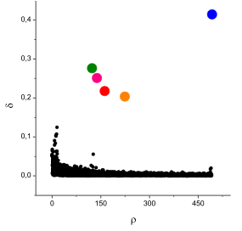
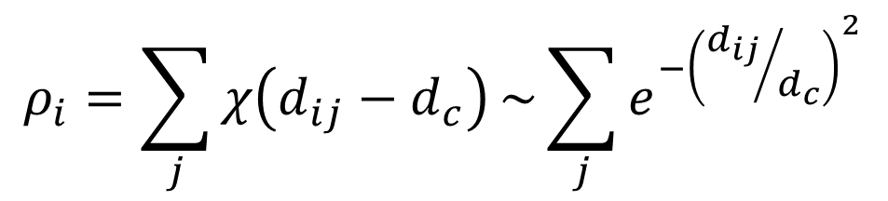
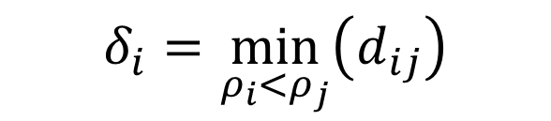
Density Peaks algorithm
Given a distance matrix d_{ij}, for each data point i compute:
$$ρ_{i}=\sum_{j}{χ\left(d_{ij}−d_{c}\right)}\sim \sum_{j}{e^{−{\left({d_{ij}}/{d_{c}}\right)}^{2}}}$$
(number of data points within a distance d_{c} or density estimation)
$$δ_{i}=\min_{ρ_{i}{<ρ}_{j}}\left(d_{ij}\right)$$
(distance of the closest data point of higher density)
Make the Decision graph:
Plot δ as a function of ρ
One free parameter: the cutoff distance d_{c}
However: the method is only sensitive to the relative density of two data points, not to the absolute value of ρ

Slide 46
Density Peaks clustering example

Slide 47
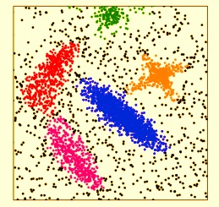
Density Peaks clustering example

Slide 48
Density Peaks clustering example

Slide 49
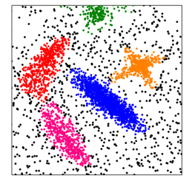
Density Peaks clustering example

Slide 50
Density Peaks clustering example

Slide 51
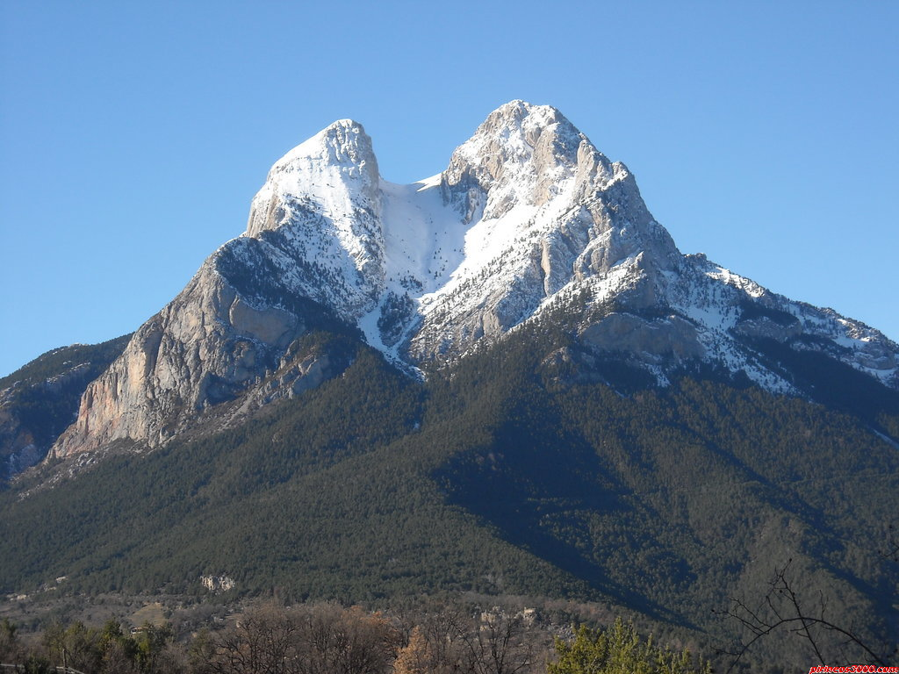


Density Peaks: Halo
Halo concept: mountain analogy
What are these black points?

Slide 52
Conclusions
Clustering aims for describe the structure of the data without a ground truth.
Usually we need to reduce the dimension of our dataset, it can be done by feature selection (semi-supervised) or by dimensional reduction (unsupervised)
The number of clustering algorithms →∞, each problem/user has its optimal method.
Look at bibliography!!!

